Slide 1
Power Systems and Management
Requirements
Supply Subsystems with Power Demands
Must supply power demands for payload and subsystems for full orbital period.
Must supply adequate battery storage to supply priority systems through non-sun lit portions of orbit.
Power Management System
Must have Power Safety Mode, provides priority systems shut off sequence to conserve low batteries.
CubeSat must be able to launch with all systems powered off and batteries fully discharged. Must be able to power on systems once deployed.
Must supply ease of access to power system’s inputs and terminals.

Slide 2
Sub-System’s Power Demands
 | Communications | ADNCS | Flight Computer/Payload(HASP) | Total Wattage Demand
Worst Scenario | Radio: 2W | GPS: 540mW
Better Scenario | Radio: 1W | GPS: 1W
Best Scenario | Radio: <1W | GPS: 1.2W
Final Comments
Notes:
The “Best” scenario for the Radio is if we can somehow use the Funcube dongle.

Slide 3
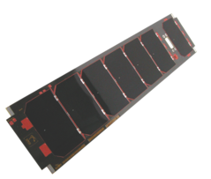
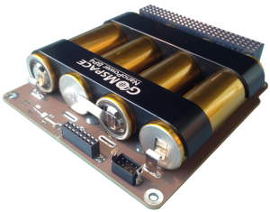
Solutions to Desired Power Consumption:
Cover four side faces with solar panels which include sun/horizon sensors
Batteries *ADD MORE INFO
Power Management Board
Subsystems

Slide 4
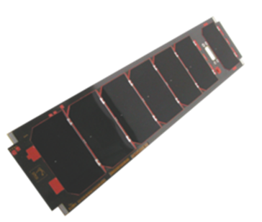
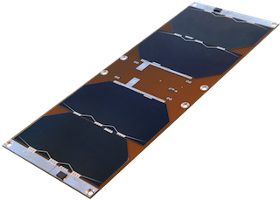
Option One:
GOMSpace 4 per 3U panel
Total Power Produced Per Panel ~6.81 W
ClydeSpace 3U Solar Panel(s)
Total Power Produced Per Panel ~6.26 W
3U Solar panel(s) →Qty of 4 desired
From ClydeSpace/GOMSpace
Can purchase pre-mounted Sun/Horizon Sensors for attitude determination
Unit Price ~ $6,700 (ClydeSpace)
Total ~ $26,000 (4 units)
Unit Price ~ $3,100 (GOMSpace)
Total ~ $36,800 (12 1U units)
GOMSpace
ClydeSpace
* Rule of thumb; true power ~ 60% of total power produced.

